Slide 1
Computer Network Lab 5

Slide 2
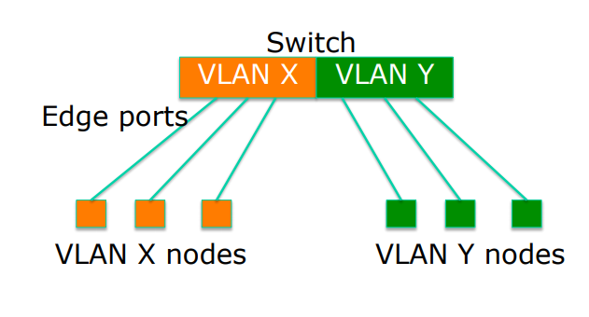
Virtual LANs (VLANs)
Allow us to split switches into separate (virtual) switches
Edge ports, where end nodes are connected, are configured as members of a VLAN
VLANs are assigned to switch ports. There is no “VLAN” assignment done on the host (usually).

Slide 3
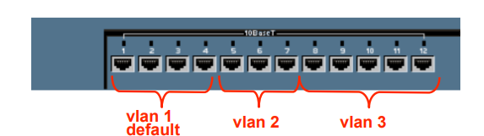
VLAN operation
As a device enters the network, it automatically assumes the VLAN membership of the port to which it is attached.
The default VLAN for every port in the switch is VLAN 1 and cannot be deleted.

Slide 4
VLANs across switches
Two switches can exchange traffic from one or more VLANs
Inter-switch links are configured as trunks, carrying frames from all or a subset of a switch’s VLANs
Each frame carries a tag that identifies which VLAN it belongs to

Slide 5
VLAN Connections
During the configuration of VLAN on port, we need to know what type of connection it has.
Switch supports two types of VLAN connection
Access link
Trunk link

Slide 6
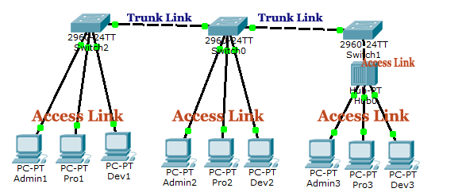
VLAN Connections
Access link
Access link connection is the connection where switch port is connected with a device
Trunk link
Trunk link connection is the connection where switch port is connected with a device that is capable to understand multiple VLANs

Slide 7
END

